Slide 1
Apps
XD

Slide 2
PhoneGap
Fills gap between web and mobile for developer
PhoneGap = Cordova (pretty much same same)

Slide 3
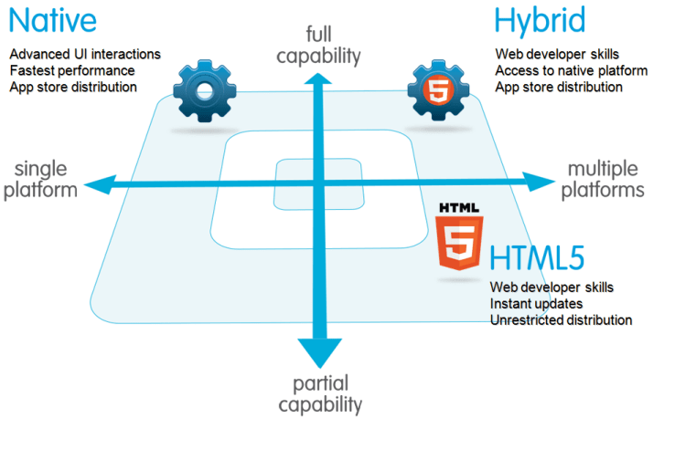

Slide 4
Native
Java (Android Studio)
Swift (Xcode)
Benefits (supposedly)
No limitations on accessing mobile features (e.g. phone flashlights, call logs etc) – although there isn’t much PhoneGap can’t access any more
Faster interface development compared to hybrid (as you are only developing for 1 type of OS) – although frameworks like Ionic are making this easy now too
Probs slightly quicker when running (we are talking micro seconds) for high data oriented apps e.g. Facebook = millions of requests per second
Limitations
E.g. if you want to make Android apps, you gotta learn Java first, then Android SDK with a complete set of APIs, then ur only going to be an eggspert making Android Apps and not much else

Slide 5
Hybrid
HTML / CSS / JavaScript for Android, iOS, Windows, BlackBerry, Firefox OS, Ubuntu Mobile and more
Single code base for all ^^ platforms
Cheap #free
Easy to learn
Quick to develop all platforms
limitations in UI Design (can be resolved using UI framework like Ionic)

Slide 6
Biggest advantage for you = reusable technology stack:
Digital Solutions – IA1 and IA2 (first 2 projects of year 12) =
HTML CSS JavaScript
Python with web frameworks (Flask)

